Slide 1
Beyond R: New Open Source Tools for Analytics
Adam McElhinney
Head of Business and Marketing Analytics
Enova International

Slide 2
Goals of this talk
Discuss why there is a need for new analytics tools
Identify what alternative analytics tools are available
Understand the pro’s and con’s of each of the tools
View specific use cases of the tools
Have a roadmap for you to get started using these resources

Slide 3
About Enova
Online lender operating in US, UK, Canada, Australia, Brazil and China
Product offerings
Installment Loans
Consumer Lines of Credit
Cash Advance
Small Business Lines of Credit
800 employees headquartered in Chicago
Over 3 million customers worldwide
40+ person Analytics department, broken into 5 teams
Business Analytics
Marketing Analytics
Credit Analytics
Fraud Analytics
Business Intelligence
Recognized as top employer
Brill Street + Company's Top 50 Employers for Gen Y Emerging Talent in Chicago 2012 & 2013
IDG's Computerworld 2013 and 2014 List of 100 Best Places to work in Information Technology
Achievers 50 Most Engaged Workplaces in the United States

Slide 4
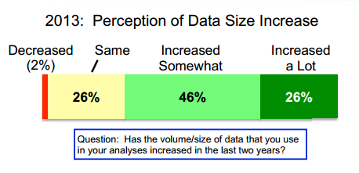
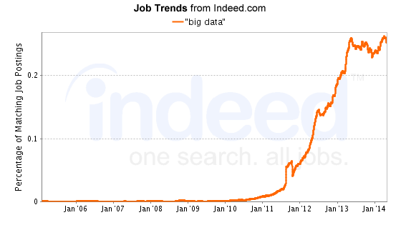
Why do we need new analytics tools?
Data sizes are increasing

Slide 5
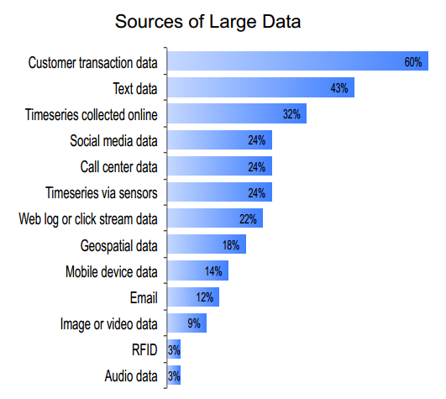
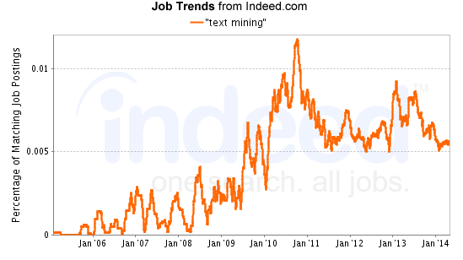
Why do we need new analytics tools?
Unstructured data growing in size and importance

Slide 6

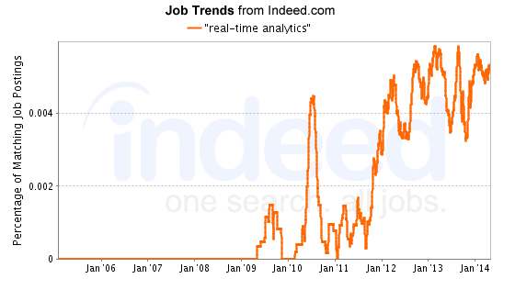
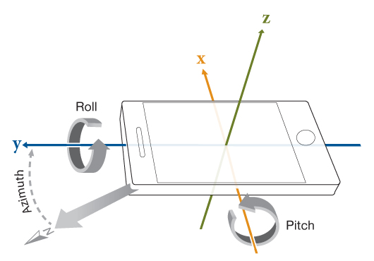
Why do we need new analytics tools?
Increased importance of real time analytics

Slide 7

Why do we need new analytics tools?
Increased pervasiveness of data analysis
Computer Science
Physics
Weka
Python
C
Fortran
Statistics
Engineering
R
SAS
Matlab

Slide 8



Why do we need new analytics tools?
New analytical methods constantly being developed

Slide 9
Why do we need new analytics tools?
In summary, we need tools that
Accommodate larger data sizes
Deal effectively with unstructured data
Easily support real-time applications
Approachable to users from a variety of academic and professional backgrounds
Support many new analytical techniques

Slide 10
Categories of Analytical Tools
Numerical Analysis Languages (NAL): languages specifically designed to perform numerical or data analysis
General Purpose Language Libraries (GPLL): code libraries for data analysis that extend the functionality of a general purpose programming language
Spreadsheet and Graphical tools (SGT): software for data analysis that is primarily driven by a point and click interface

Slide 11
Categories of Analytical Tools
Numerical Analysis Languages
Examples: SAS, R, Matlab, Julia, Fortran
Pro’s:
Can be very fast
Extensive support for a variety of analytical techniques
Many very mature options
Con’s:
Steep learning curve
Language portability issues
May be specific to one academic discipline or analysis

Slide 12
Categories of Analytical Tools
General Purpose Language Libraries
Examples: Scikit-Learn (Python), StatsPy (Python), Weka (Java)
Pro’s:
Easy to learn (for those familiar with basic programming)
Simple to integrate with other programs
Con’s:
Varying levels of speed
Inconsistent analytical coverage

Slide 13
Categories of Analytical Tools
Spreadsheet and Graphical tools
Examples: Excel (XLStat, @Risk), Gnumeric, SPSS, PSPP, OpenStat, RapidMiner
Pro’s:
Easy to learn (even for those NOT familiar with basic programming)
Can be used by people without formal statistical training
Con’s:
Very slow
Limited techniques available
Poor integration with other technologies

Slide 14
Some Options
Tool | Type | Notes
Excel | SGT | Over 1 billion users, in all industries and skill levels. By far the most well known data analysis tool. Can be extended with 3rd party add-ins.
Gnumeric | SGT | Designed as an open source alternative to Excel with an emphasis on statistical analysis. Collaborates with R community to ensure high level of statistical accuracy and feature set.
PSPP | SGT | Designed as an open source replacement for SPSS. Mimics SPSS layout, but has limited functionality.
OpenStat | SGT | Provides an SPSS like interface with lots of capabilities. However, is only supported by a handful of developers and community is dwindling.
RapidMiner | SGT | Based on a point and click interface. Very powerful functionality and easy to use. Older versions of the code with limited functionality are open source.
R | NAL | Specialized programming language for statistical analysis. By far the most comprehensive set of statistical tools available, but learning curve is steep.
Octave | NAL | Designed as open source alternative to Matlab. Most Matlab code is directly compatible with Octave.
Julia | NAL | Specialized programming language for technical computing. Designed to replace R, Matlab and C in one language. Relatively new and immature.
Java & Weka | GPLL+ SGT | A powerful set of data mining and statistics algorithms implemented in Java. Also provides GUI. Very popular with machine learning community.
Python & Orange & Scikit & Pandas | GPL + SGT | A general purpose programming language that prides itself on being easy to learn and fast development. Has very power machine learning and statistics libraries., with GUI’s available. Very active developer community.

Slide 15
Scoring Some Options
Tool | Large Data Sets* | Unstructured Data | Real- Time | Variety of Backgrounds | Technique Support
R | High | Medium | Medium | Medium | High
Weka (Java) | Medium | Medium | High | Low | Medium
Python | High | High | High | High | Medium
Julia | Medium | Low | Low | Medium | Low
Notes on Scoring
Python includes Python + Orange + Scikit-learn + Statspy + Pandas
Rating based on “out of the box” support, or support with code imports
Each technology has significant customization capabilities (question of performance vs. effort)
Large Data Set Notes
R offers libraries to deal with data too large to fit in memory
Python typically processes and reads data significantly faster than R
Julia is by far the fastest language, but is much less mature
Weka (Java) can interface with Hadoop and other “Big Data” technologies

Slide 16
Use Cases
Scenario 1: Bread and Butter Data Analysis
Feature | Response
Analysis Frequency | One-time analysis
Data Structure | Structured
Statistical Sophistication | Medium - High
Real-time Output | Not Needed
Analyst Time vs. Performance | Analyst time more important
Programming Competency | Medium
Recommended toolset: R
Example Analysis:
Ad-hoc requests
Customer lifetime value modeling
Direct mail response modeling
Customer Attrition

Slide 17
Use Cases
Scenario 2: Continuously Updating Models
Feature | Response
Analysis Frequency | Continuous Updates
Data Structure | Structured or Unstructured
Statistical Sophistication | Medium - High
Real-time Output | Required
Analyst Time vs. Performance | Performance more important
Programming Competency | Medium- High
Recommended toolset: Python
Example Analysis:
Real-time fraud detection
Automated credit scoring
Call center prioritization
Real-time compliance monitoring

Slide 18
Use Cases
Scenario 3: Cutting-edge Research
Feature | Response
Analysis Frequency | One-time or Continuous
Data Structure | Structured
Statistical Sophistication | High
Real-time Output | May or may not be required
Analyst Time vs. Performance | Performance most important factor
Programming Competency | High
Recommended toolset: Julia
Example Analysis:
Very intense simulations
Complex financial calculations
Anything where computational performance is limiting factor

Slide 19
Use Cases
Scenario 4: Feature Extraction
Feature | Response
Analysis Frequency | One-time or Continuous
Data Structure | Highly Unstructured
Statistical Sophistication | Low – High
Real-time Output | May or may not be required
Performance | Analyst time more important
Programming Competency | Medium
Recommended toolset: Python
Example Analysis:
Social media monitoring
Drawing data from web sources
Parsing large quantities of text

Slide 20
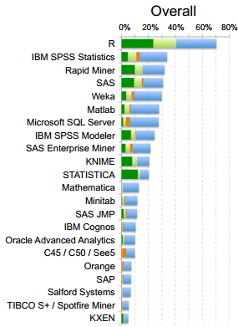

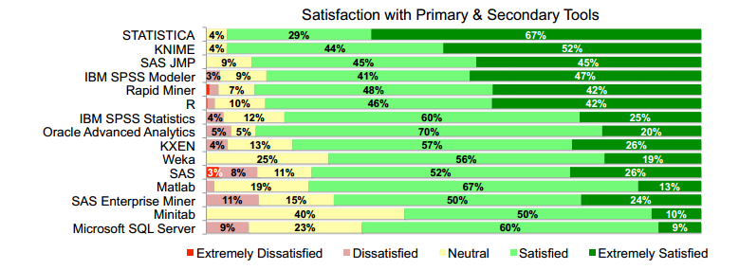
Open Source Penetration
Open source tools making headway
Satisfaction is varied

Slide 21


Closer Look At Some Tools
Gibbs Sampler: way of approximating a joint distribution where direct sampling is difficult. Relies on the conditional distributions.

Slide 22
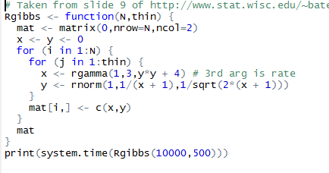
Closer Look At Some Tools
R: 51.34 second runtime

Slide 23
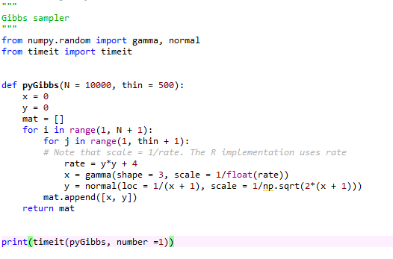
Closer Look At Some Tools
Python: 16.51 second runtime

Slide 24
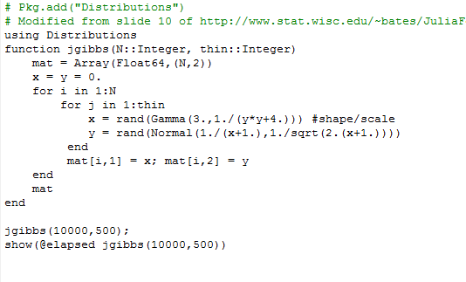
Closer Look At Some Tools
Julia: .55 second runtime

Slide 25
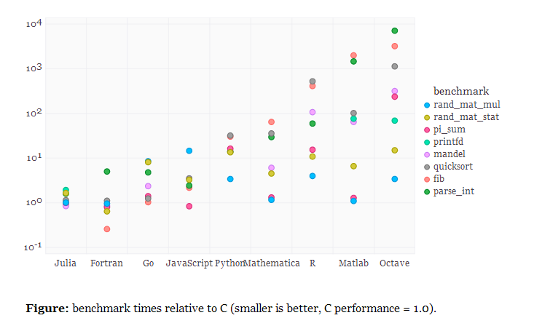
Speed Benchmarks

Slide 26
How to Get Started
Recommend getting started with Python
Most flexible platform
Can be optimized later if speed becomes an issue
Can interface with a number of other languages easily

Slide 27
How to Get Started
Purposed Training Schedule to Transition from Excel to Python. Programmers proficient in another general purpose language may want to skip 1 & 2.
1. Complete Code Academy Python Trainings 1-21
2. Complete MIT OpenCourse Intro to CS 2011 Problem Sets 0-9
3. Read and Follow Along with “Getting Started with Pandas - Predicting SAT Scores for New York City Schools”
4. Read and follow along with Michael Becker’s “Intro to scikit-learn” talk
5. [Optional] Read Python for Data Analysis (free e-book)

Slide 28
References
Slides 4, 5 and 19: All survey results taken from the 2013 Data Miner Survey http://www.rexeranalytics.com/Data-Miner-Survey-Results-2013.html
Slides 4, 5 and 6: Job trends data from indeed.com
Slide 7: Article taken from http://arstechnica.com/science/2014/05/scientific-computings-future-can-any-coding-language-top-a-1950s-behemoth/
Slides 20, 21 and 23: Gibbs sampler problem and code borrowed from http://www.stat.wisc.edu/~bates/JuliaForRProgrammers.pdf
Slide 24: Language speed benchmarks taken from http://julialang.org/benchmarks/

